Slide 1
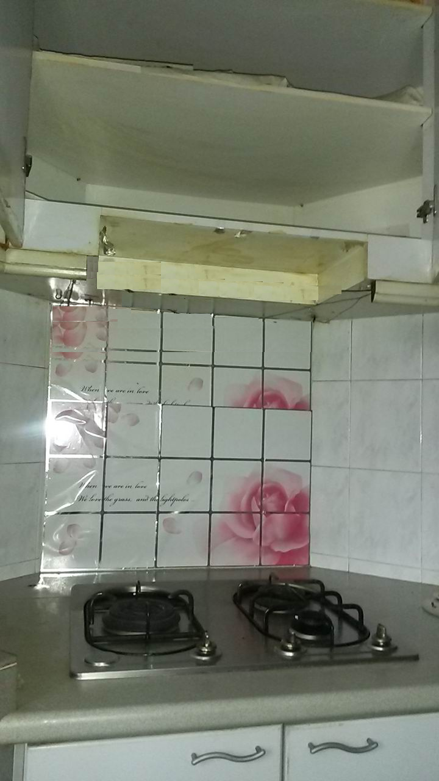
W:80cm
H: 75cm
(to ceiling)
W:56cm
W:60cm
H: 8cm
W:90cm
D:30cm
W:75cm
D:54cm(to wall)
W:90cm D:>50cm(to wall)
H: 70cm
D:>50cm(to wall)
D:54cm
(to wall)
W: 50cm
L: 60cm

